Slide 1

AMEX Enabled Registration Guide
November 2024|

Slide 2
AMEX Enabled Company Registration + Knowledge Base User Enrollment

Slide 3
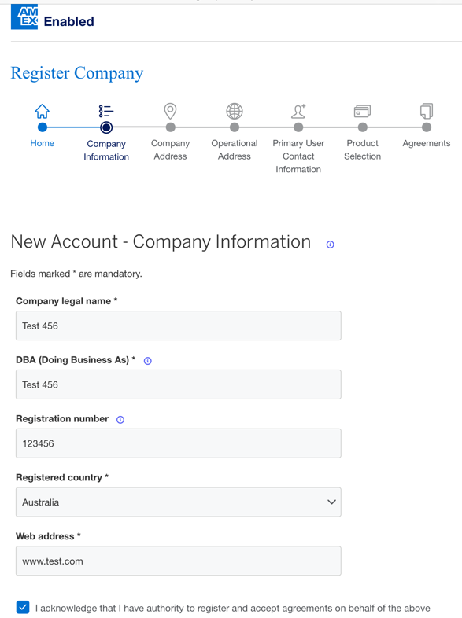
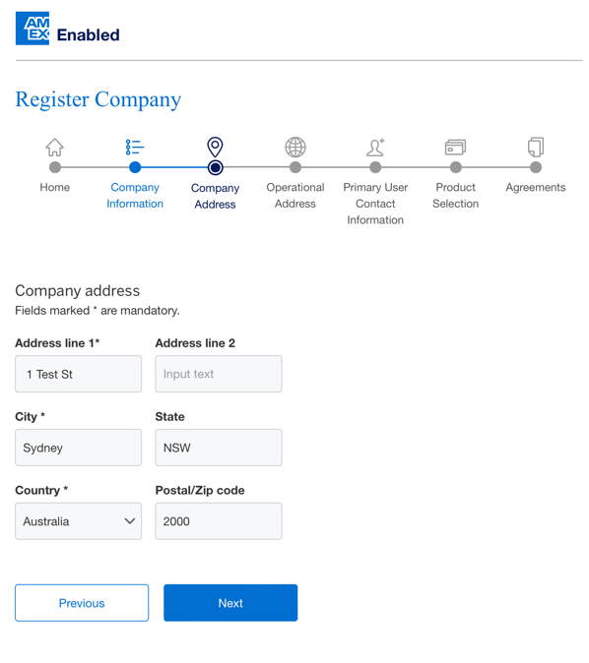
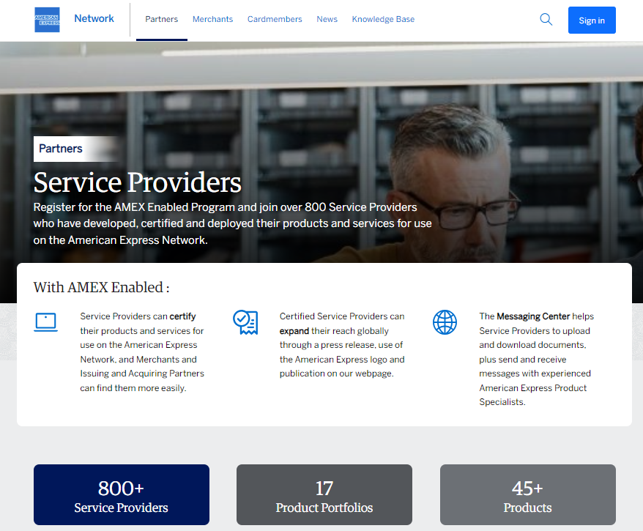
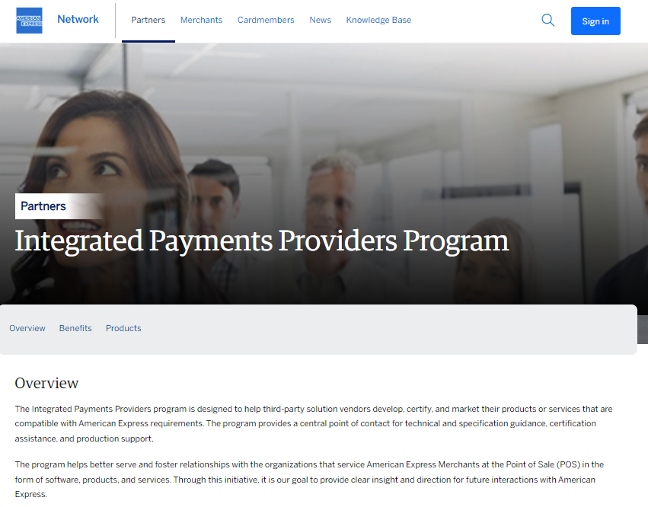
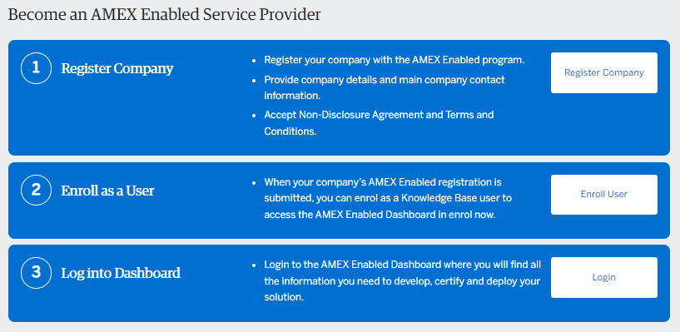
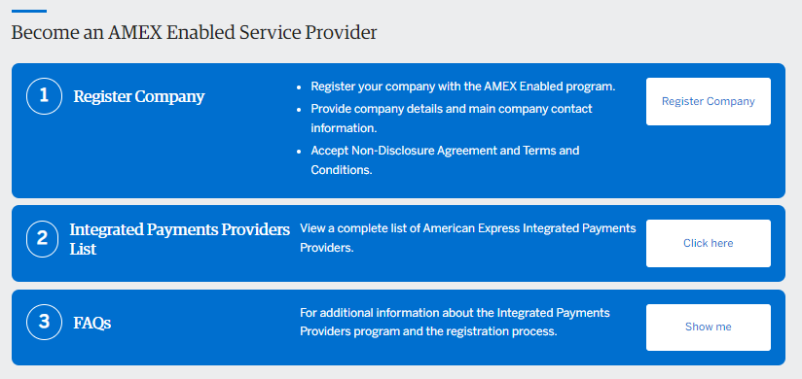
AMEX Enabled Company Registration + Knowledge Base User Enrollment
New Service Provider and New User Journey
Access AMEX Enabled Service Provider homepage OR Integrated Payments Provider homepage Commence Step 1 – Register Company | Complete Company Information New Account = Brand New Partner Existing Partner = Existing KB Partner Registration Number is non-mandatory Ensure user completing the Company Registration can complete Agreements on behalf of the Company | Complete Company Information
AMEX Enabled Homepage
IPP Homepage

Slide 4
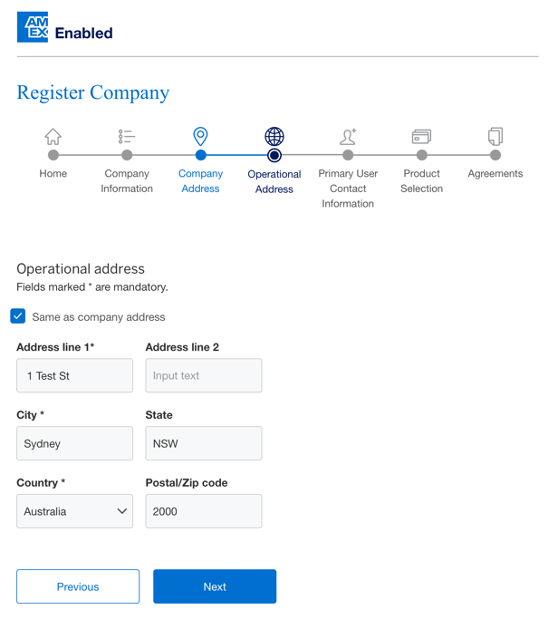
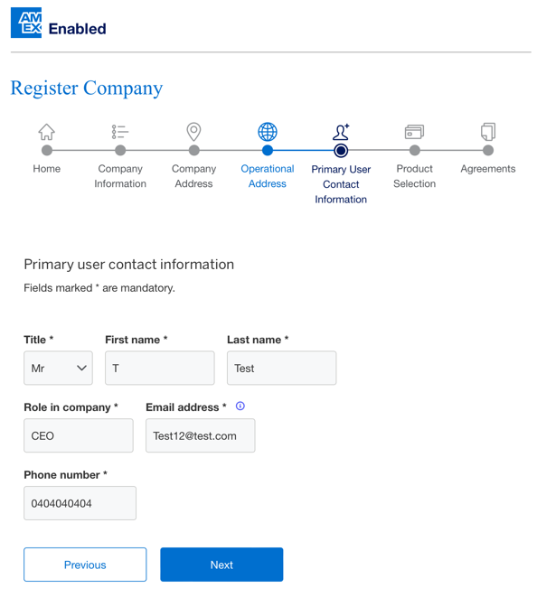
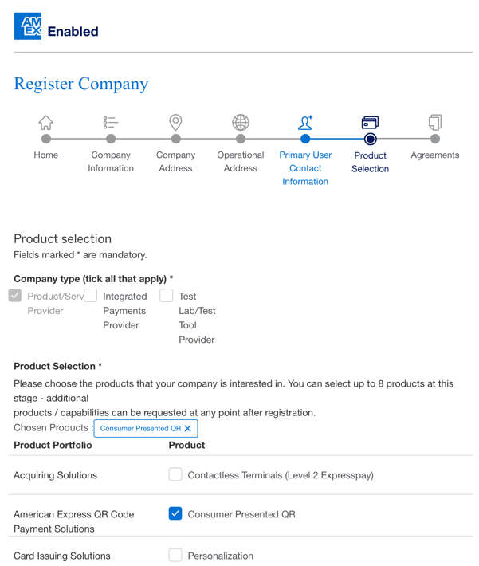
AMEX Enabled Company Registration + Knowledge Base User Enrollment
New Service Provider and New User Journey
Complete Operational Address or select ‘tick box’ if the same as Company Address | Complete Primary User Contact Information. Please ensure a business email address is used and not a generic email address e.g., @google.com or @yahoo.com | Select products/services required Up to 8 products/services can be selected during Company Registration. Additional products/services can be requested once AMEX Enabled Dashboard access is granted

Slide 5
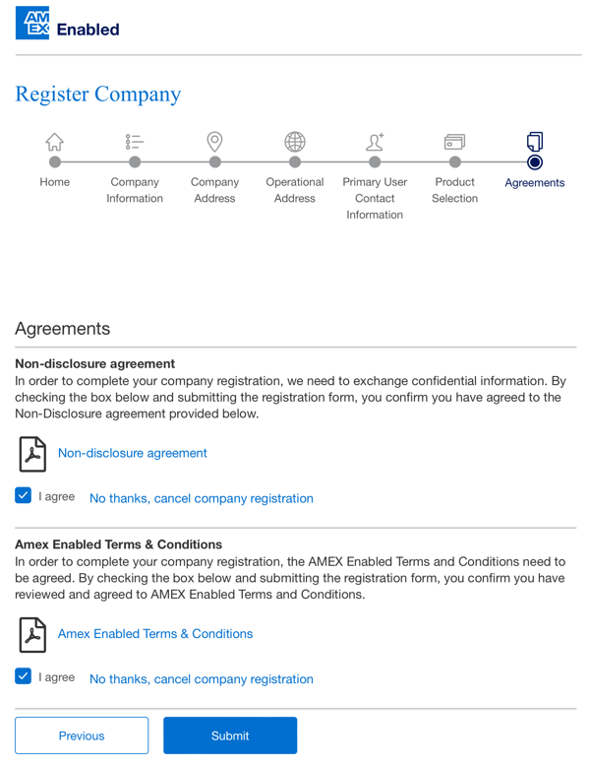
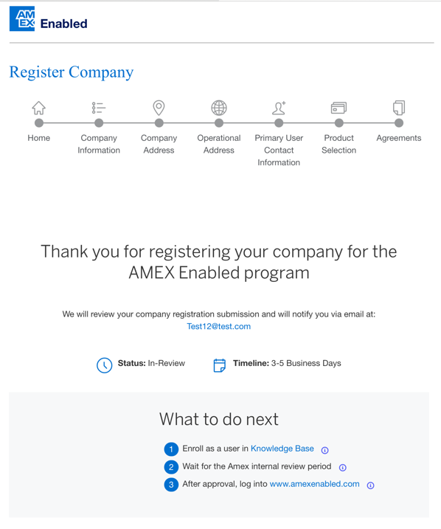
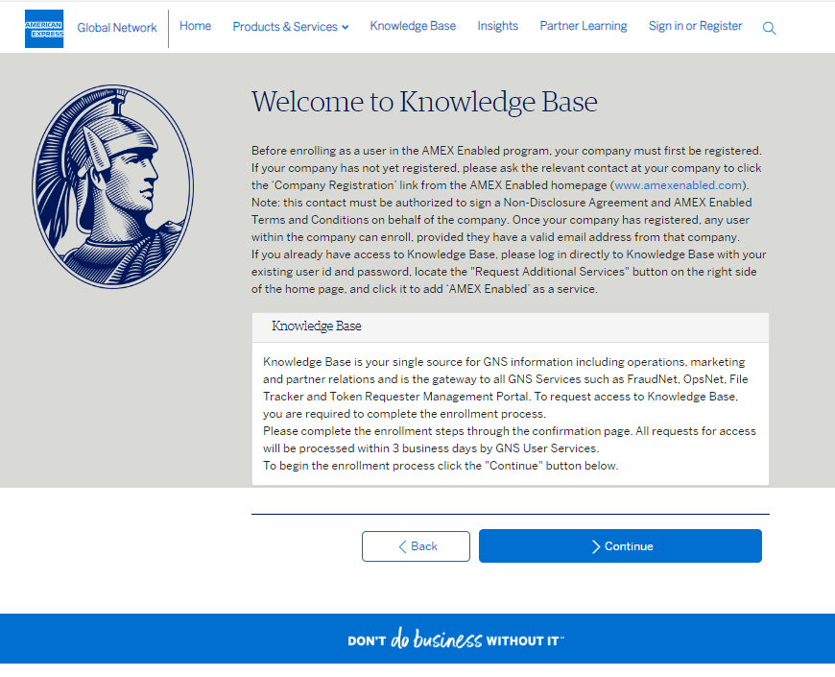
AMEX Enabled Company Registration + Knowledge Base User Enrollment
New Service Provider and New User Journey
Agreements will be presented based on products/services selected. i.e. If an Integrated Payments Providers (IPP) product/service is requested, IPP T&CS will also be presented. Agreements can be downloaded | AMEX Enabled Company Registrations are submitted to respective product teams for review and approval New users should then complete Knowledge Base user enrollment by selecting the ‘Knowledge Base’ hyperlink | Commence Knowledge Base user enrollment

Slide 6
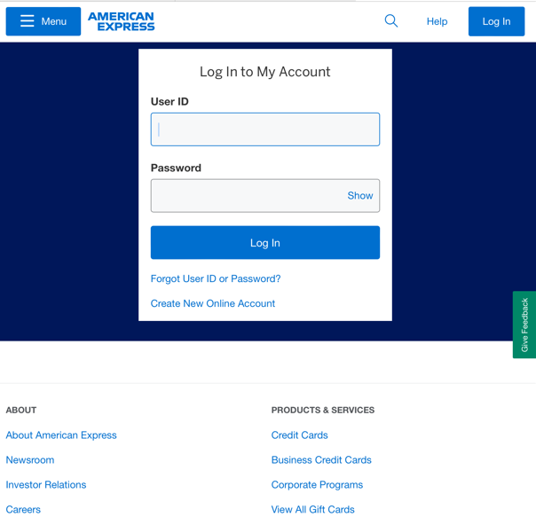
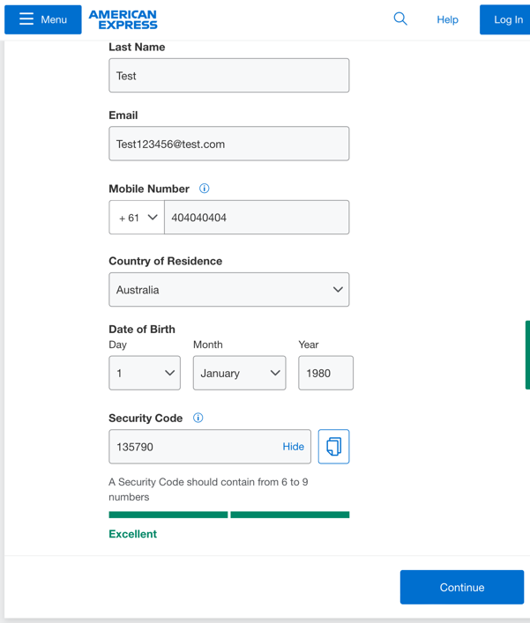
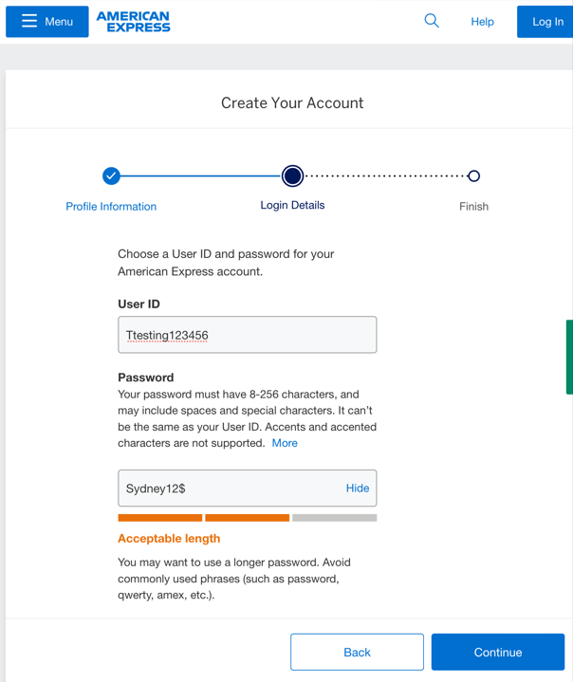
AMEX Enabled Company Registration + Knowledge Base User Enrollment
New Service Provider and New User Journey
A new Knowledge Base user should select ‘Create New Online Account’ hyperlink | New users should start by setting up their OneIdentity credentials Amex card holders should not use the same email address they have registered for online card services in this section | OneIdentity credentials include creation of a Security Code, User ID and Password

Slide 7
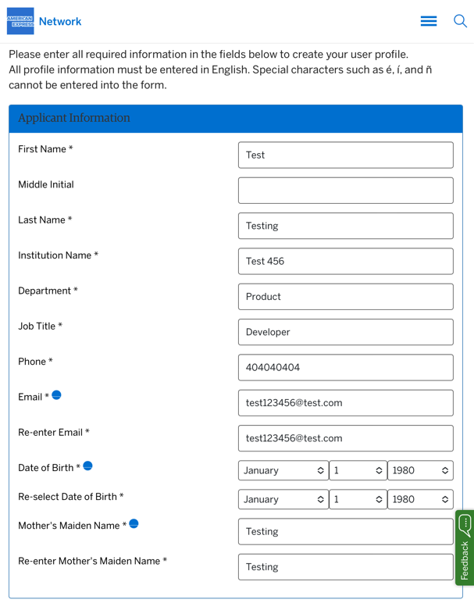
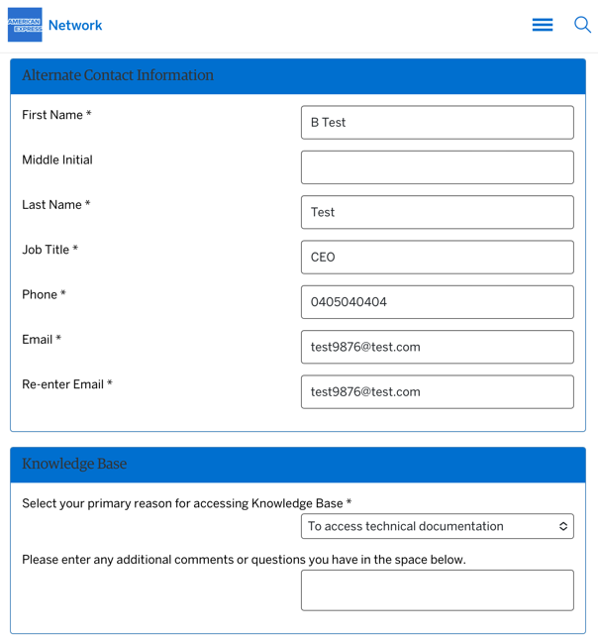
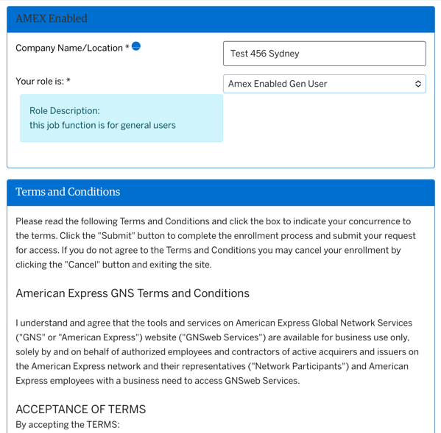
AMEX Enabled Company Registration + Knowledge Base User Enrollment
New Service Provider and New User Journey
User can then log in using OneIdentity credentials and complete their Knowledge Base application Amex card holders should not use the same email address they have registered for online card services in this section | Ensure accurate information such as Institution/Company Name and Alternate Contact Information is submitted to ensure smooth review and approval of application Alternate Contact Information should be different than Applicant Information | Knowledge Base User enrollment includes a request to add AMEX Enabled access to user’s permissions Knowledge Base user requests are submitted to GNS User Services for review and approval.

Slide 8
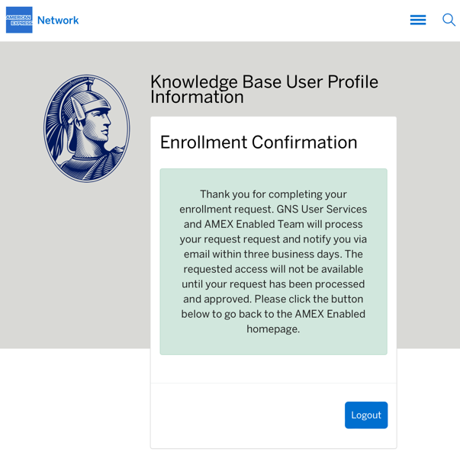
AMEX Enabled Company Registration + Knowledge Base User Enrollment
New Service Provider and New User Journey
Enrollment Confirmation page confirms successful submission. SLA for review of Knowledge Base user enrollment is 3 Business Days

